Slide 1

Perencanaan Sistem Listrik untuk Industri
TEL 12072
Universitas Medan Area
Fakultas Teknik
Oleh
Dr Ir Dina Maizana MT
maizanadina@gmail.com

Slide 2

Mari kita berdoa menurut agama dan kepercayaan masing-masing sebelum kelas dimulai.
Doa dimulai…

Slide 3
Agenda
Kebutuhan daya (Power Demand)
Aliran daya (Power Flow)
Arus beban ( Load Current)
Proteksi gangguan (Protection on Fault)
Cadangan daya ( Power
Unbreakable PS
Harmonik
Pentanahan
Penangkal petir
Kapasitor bank
Penghematan

Slide 4
Aliran Daya
Power Flow
is a numerical analysis of the flow of electric power in an interconnected system. A power-flow study usually uses simplified notations such as a one-line diagram and per-unit system, and focuses on various aspects of AC power parameters, such as voltages, voltage angles, real power and reactive power. It analyzes the power systems in normal steady-state operation.

Slide 5
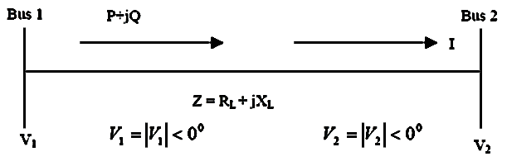
PSA
Relation between Voltage, Power and Reactive Power

Slide 6
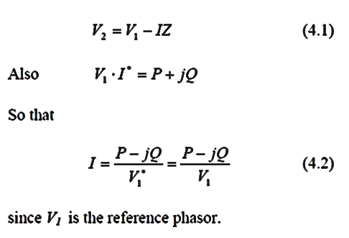
Aliran Daya

Slide 7
Voltage Drop
One of the most important constraints on distribution system design is the voltage level at the customer intake point.
This is particularly important for the vast majority of customer taking supplies at low voltage with no means of adjusting the voltage received.
A knowledge of the voltage at different locations can indicate the strong and weak parts of a networks.

Slide 8
Voltage Drop
The voltage drop phasor V_{d} for a section of line having an impedance Z and carrying current I is given by
In distribution system it is the arithmetic difference between sending and receiving end voltages which is the more useful voltage drop value.
A close approximation to this can be obtained from the simplified equivalent

Slide 9
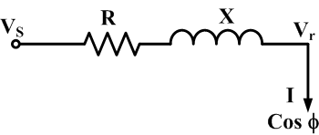
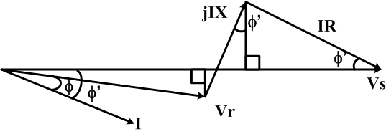
Voltage Drop
The figure has resistance R, reactance X, sending end voltage V_{S} and receiving end voltage V_{r}. . It carries current I lagging on V_{r} .
During normal load-flow conditions the angle between the receiving and sending end voltage V_{r} and V_{S} is only a few degrees.
For most practical cases the approximation φ≈φ’ is acceptable.

Slide 10
Voltage Drop
The scalar relationship can be written as
The voltage drop Vd in the line is given by
I_{P} and I_{q} represent the resistive and reactive component of load current I

Slide 11
Voltage Drop
In single phase calculations the resistance and reactance of the return path must be included in R and X.
For 3-phase systems the line-line voltage drop can be calculated from
Where V is line – line voltage and P is the total 3 phase power

Slide 12
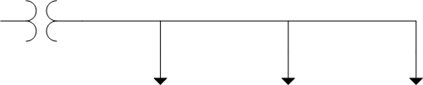
Voltage Drop
Example 4.2
Consider the three phases four wire 416 V secondary system with balanced loads at A, B and C as shown in figure below.
Determine the following:
  Calculate the total voltage drop using the approximate method
  Calculate the real power per phase for each load
  Calculate the reactive power per phase for each load
  Calculate the kilovolt ampere output and load power factor of the distribution transformer
0.05 + j0.01 Ω/ø
A
0.1 + j0.02 Ω/ø
B
0.05+j0.05 Ω/ø
C
Distribution
transformer
30 A
Unity p.f.
20 A
Cos θ_{B} = 0.5
lagging
50 A
Cos θ_{C} = 0.9
lagging

Slide 13
Voltage Drop
Solution
Using the approximation voltage drop equation
V_{d} = I(R cosθ + X sinθ)
The voltage drop for each load
V_{d(A)} = 30(0.05x1.0+0.01x0) = 1.5 V
V_{d(B)} = 20(0.15x0.5+0.03x0.866) = 2.02 V
V_{d(C)} = 50(0.2x0.9+0.08x0.436) =1 0.744 V
Therefore, the total voltage drop is
V_{d(Total)} = V_{d(A)}+V_{d(B)} V_{d(C)} = 14.264 V

Slide 14
Voltage Drop
Solution
The real power per phase for each load P=VI cos θ
the single phase voltage,
P_{A}=240(30)(1.0)=7.2kW
P_{B}=240(20)(0.5)=2.4kW
P_{C}=240(50)(0.9)=10.8kW
The total real power per phase is: ∑ P_{A}+P_{B}+P_{C}=20.4kW
The reactive power per phase each load Q=VI sin θ
Q_{A}=240(30)(0)=0kvar
Q_{B}=240(20)(0.866)=4.156kvar
Q_{C}=240(50)(0.436)=5.232kvar
The total reactive power per phase is:∑ Q_{A}+Q_{B}+Q_{C}=9.389kvar

Slide 15
Voltage Drop
Solution
The KVA output of the distribution transformer
Total KVA output of the distribution transformer is
The load power factor of the distribution is

Slide 16
Power Factor
Power factor is the ratio between actual (true) load power (kW) and the apparent load power (kVA)
It is a measure of how effectively the current is being converted into useful work output and more particularly is a good indicator of the effect of the load current on the efficiency of the supply.

Slide 17
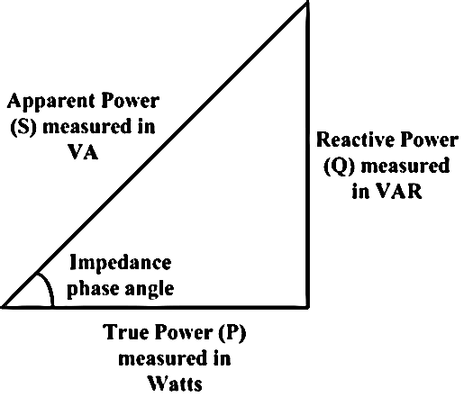
Power Factor
Fundamental of Basic Electricity - The Power Triangle
P - kW
Q - kVar
S - kVA

Slide 18
Power Factor
Equipment Causing Poor Power Factor
Lightly loaded induction motor. Examples of this type of equipment and their approximate power factor are:
  70% power factor or better: Air conditioners, pumps, center less grinders, cold header, up setter, fans or blower
  60% to 70% power factor: Induction furnaces, standard stamping machines and weaving machines
  60% power factor and below: Single-stroke presses, automated machine tools, finish grinders, welders

Slide 19
Power Factor
Reactive Power Problem (Motor)
Example that a motor is rated at 10,000W at 0.8 power factor. The resistance is 5ohm. At 415V, the motor will require the following amount of current:
I=10000/(√3x0.8x415)=17.39A
Losses when pf =0.8 : I²R=(17.39)²(5)=1,512W
The same motor rated at 0.65 power factor will require:
I=10000/(√3x0.65x415)=21.403A
Losses when pf=0.65 : I²R=(21.403)²(5)=2290.4W
Low Power Factor = Higher Losses

Slide 20
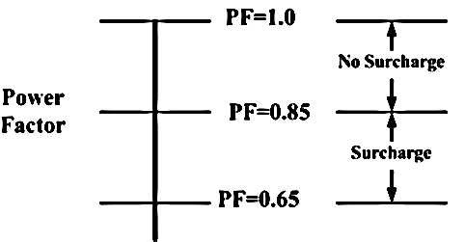
Power Factor
Minimum Power Factor
Customers are advise to maintain power factor at minimum of 0.85

Slide 21
Power Factor
How to Improve Power Factor
Customers are advised to follow these steps:-
Install capacitors (KVAR Generators)
  Capacitor
  Corrector
  Synchronous generators
  Synchronous motors
Minimise operations of idling or lightly loaded motors.
Avoid operating equipment above its rated voltage.
Replace standard motors as they burn out with energy efficient motors.

Slide 22
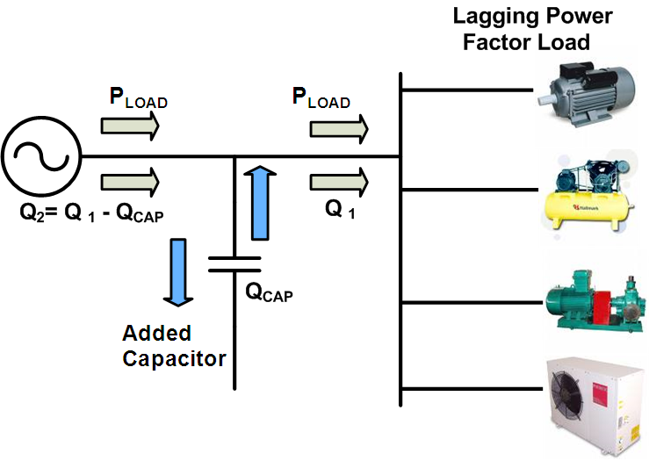
Power Factor
Power Factor Improvement
Example Of Power Flow Diagram Of Industrial Plant

Slide 23
Power Factor
Benefits of Improving Power Factor
Benefit 1: Reducing KW billing demand
Low Power Factor requires high reactive power (KVAR) and apparent power (KVA), which is the power that electric utilities supplies. Therefore, a facility’s low power factor forces electric utilities to increase its generation and transmission capacity in order to handle this extra demand.
By increasing power factor, customers use less KVAR. This results in less KW, which equates to cost savings for electric utilities .
Benefit 2: Eliminating power factor surcharge
Utility companies all around the world charge customers an additional surcharge when their power factor is less than 0.95. In fact, some utilities are not obliged to deliver electricity to their customers at any time the customer’s power factor falls below 0.85.

Slide 24
Power Factor
Thus, customer can avoid this additional surcharge by increasing power factor.
Benefit 3: Increased system capacity and reduced system losses in electrical system
Low power factor causes power system losses in the customer’s electrical system. By improving power factor, these losses can be reduced. With the current rise in the cost of energy, increased facility efficiency is important. Moreover, with lower system losses, customers are able to add additional load in their electrical system.

Slide 25
Power Factor
Benefit 4: Increased voltage level in electrical system, resulting in more efficient motors
As mentioned before, low power factor causes power system losses in customer’s electrical system. As power losses increase, customer may experience a voltage drop. Excessive voltage drops can cause overheating and premature failure of motors and other inductive equipment.
Therefore, by raising the power factor, customers can minimize these voltage drops along feeder cables and avoid related problems. Motors will run more efficiently, with a slight increase in capacity and starting torque.

Slide 26
Aliran Daya
Pada suatu industri yang menggunakan Listrik dari PLN untuk kebutuhan berbagai peralatan listriknya, adapun listrik yang digunakan adalah listrik 3 fasa dengan tegangan 380V/220V, dengan rincian kebutuhan daya berbagai peralatan listrik yang digunakan sebagai berikut:

Slide 27
Aliran Daya
1 unit Elektro motor 3 fasa 380 V daya 75 kW
1 unit Elektro motor 3 fasa 380 V daya 30 kW
1 unit Elektro motor 3 fasa 380 V daya 15 kW
1 unit Elektro motor 3 fasa 380 V daya 7,5 kW
1 unit Heater 3 fasa 380 V daya 22 kW
1 unit blower 3 fasa 380 V 18 kW
30 buah lampu mercury 250 W (10 buah/fasa) total (30 x250) / 3 = 2,5kW

Slide 28



Aliran Daya
380V/220V
0.05 + j0.01 Ω/ø
3 ph, 380 V, 75 kW, R = 2 Ω
0.05 + j0.01 Ω/ø
3 ph, 380 V, 30 kW, R = 2 Ω
0.05 + j0.01 Ω/ø
3 ph, 380 V, 15 kW, R = 2 Ω
0.05 + j0.01 Ω/ø
3 ph, 380 V, 7,5 kW, R = 2 Ω
0.05 + j0.01 Ω/ø
3 ph, 380 V, 22 kW, R = 5 Ω
0.05 + j0.01 Ω/ø
3 ph, 380 V, 18 kW, R = 2 Ω
30 buah lampu mercury 250 W (10 buah/fasa) total (10 x250) / 3 = 2,5kW, R = 1 Ω
0.05 + j0.01 Ω/ø

Slide 29
Aliran Daya
Determine the following:
  If each load have pf = 0.85,
    Calculate the total voltage drop using the approximate method
    Calculate the reactive power per phase for each load
    Calculate the kilovolt ampere output and load power factor of the distribution transformer
    Calculate losses for each load
    Calculate total losses that produce by load.

Slide 30
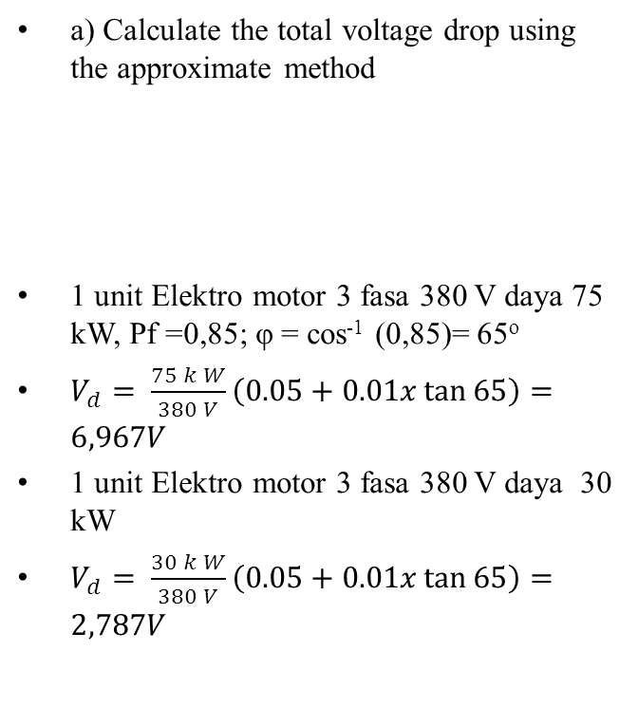
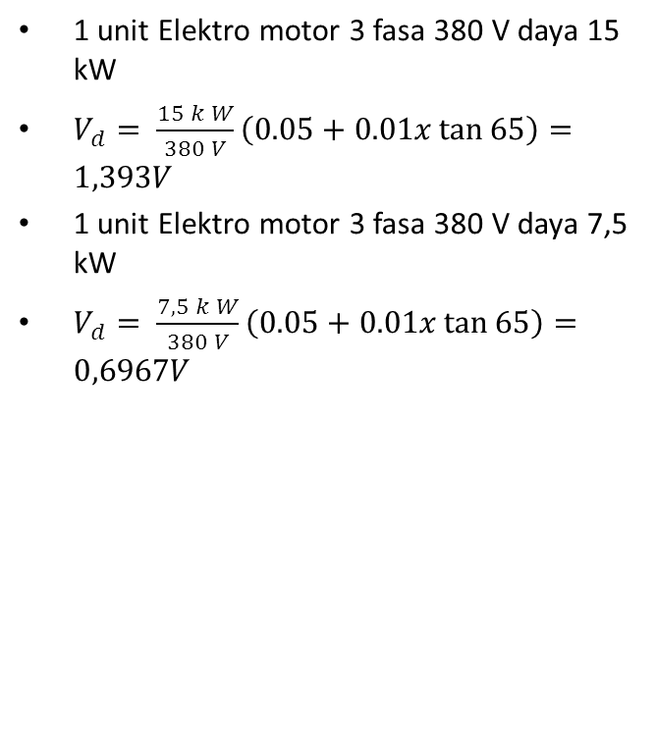
Aliran Daya
R = 0.05 ; X = j0.01 Ω/ø
    a) Calculate the total voltage drop using the approximate method
1 unit Elektro motor 3 fasa 380 V daya 75 kW, Pf =0,85; φ = cos⁻¹ (0,85)= 65º
$V_{d}= \frac{75 k W}{380 V}\left(0.05+0.01x\tan{65}\right)=6,967V$
1 unit Elektro motor 3 fasa 380 V daya 30 kW
$V_{d}= \frac{30 k W}{380 V}\left(0.05+0.01x\tan{65}\right)=2,787V$
1 unit Elektro motor 3 fasa 380 V daya 15 kW
$V_{d}= \frac{15 k W}{380 V}\left(0.05+0.01x\tan{65}\right)=1,393V$
1 unit Elektro motor 3 fasa 380 V daya 7,5 kW
$V_{d}= \frac{7,5 k W}{380 V}\left(0.05+0.01x\tan{65}\right)=0,6967V$

Slide 31
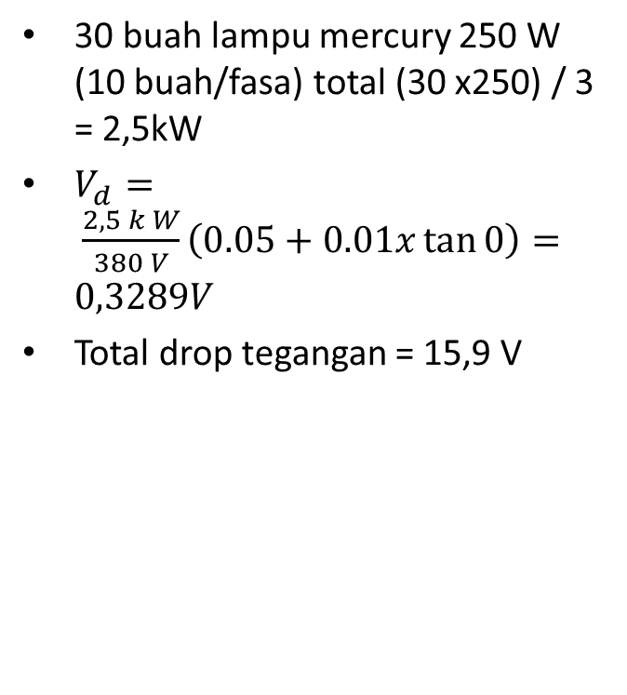
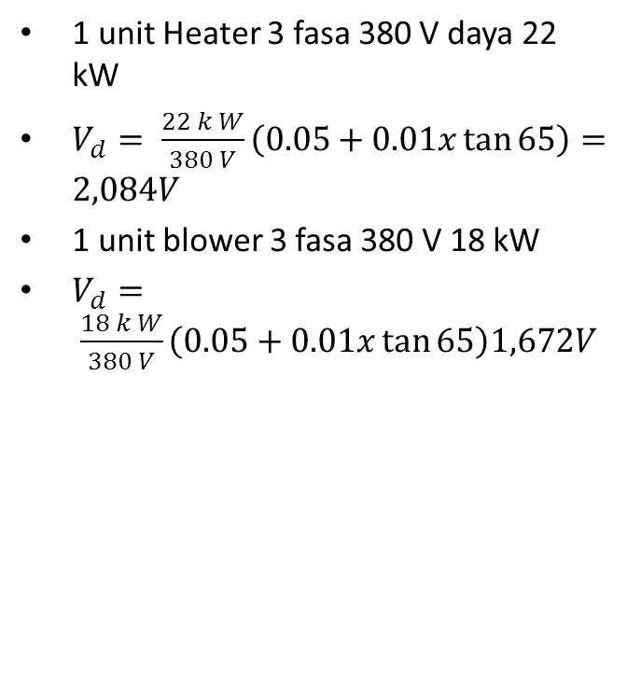
Aliran Daya
1 unit Heater 3 fasa 380 V daya 22 kW
$V_{d}= \frac{22 k W}{380 V}\left(0.05+0.01x\tan{65}\right)=2,084V$
1 unit blower 3 fasa 380 V 18 kW
$V_{d}= \frac{18 k W}{380 V}\left(0.05+0.01x\tan{65}\right)1,672V$
30 buah lampu mercury 250 W (10 buah/fasa) total (30 x250) / 3 = 2,5kW
$V_{d}= \frac{2,5 k W}{380 V}\left(0.05+0.01x\tan{0}\right)=0,3289V$
Total drop tegangan = 15,9 V

Slide 32
Aliran Daya
P=VI cos θ; I = P/V cos θ
Q=VI sin θ = V(P/V cos θ) sin θ = P tan θ
1 unit Elektro motor 3 fasa 380 V daya 75 kW, Pf =0,85; φ = cos⁻¹ (0,85)= 65º
Q = 75 kW tan 65º = 110 kVAr
1 unit Elektro motor 3 fasa 380 V daya 30 kW,
Q = 30 kW tan 65º = 64,34 kVAr
1 unit Elektro motor 3 fasa 380 V daya 15 kW,
Q = 15 kW tan 65º = 32,17 kVAr
1 unit Elektro motor 3 fasa 380 V daya 7,5 kW,
Q = 7,5 kW tan 65º = 16,08 kVAr
1 unit Heater 3 fasa 380 V daya 22 kW
Q = 22 kW tan 65º = 47,18 kVAr
1 unit blower 3 fasa 380 V 18 kW
Q = 18 kW tan 65º = 38,6kVAr
30 buah lampu mercury 250 W (10 buah/fasa) total (30 x250) / 3 = 2,5kW
Q = 2,5 kW tan 65º = 5,36 kVAr
Total daya reaktif = 313,73 kVAr

Slide 33
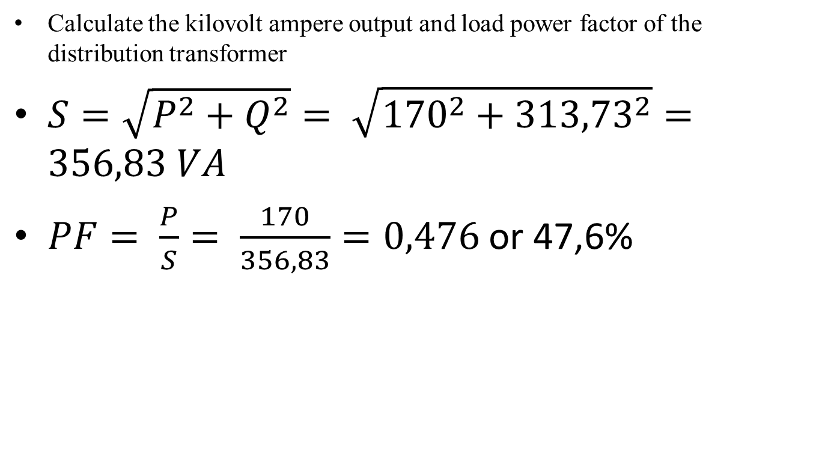
Aliran Daya
    Calculate the kilovolt ampere output and load power factor of the distribution transformer
$S=\sqrt{P^{2}+Q^{2}}= \sqrt{{170}^{2}+{313,73}^{2}}=356,83 VA$
$PF= \frac{P}{S}= \frac{170}{356,83}=0,476$ or 47,6%

Slide 34
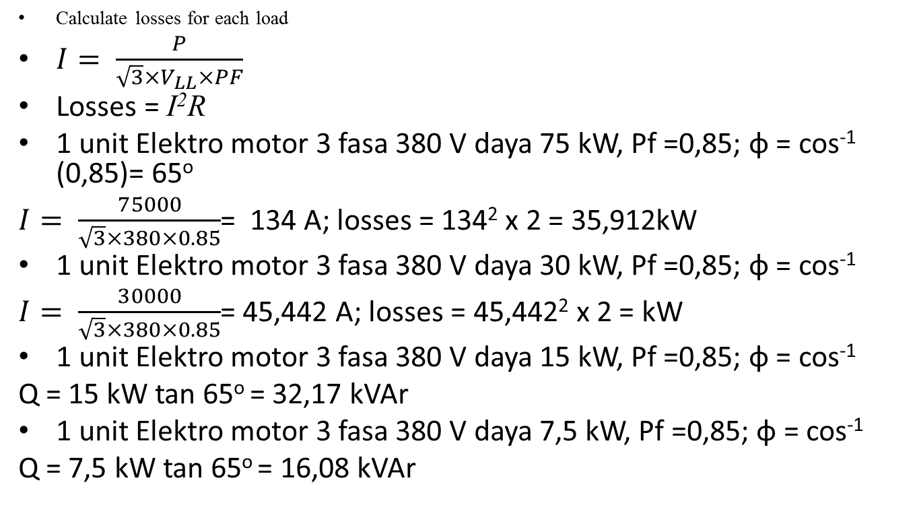
Aliran Daya
    Calculate losses for each load
$I= \frac{P}{{\sqrt{3}×V}_{LL}×PF}$
Losses = I²R
1 unit Elektro motor 3 fasa 380 V daya 75 kW, Pf =0,85; φ = cos⁻¹ (0,85)= 65º
$I= \frac{75000}{\sqrt{3}×380×0.85}$= 134 A; losses = 134² x 2 = 35,912kW
1 unit Elektro motor 3 fasa 380 V daya 30 kW, Pf =0,85; φ = cos⁻¹
$I= \frac{30000}{\sqrt{3}×380×0.85}$= 45,442 A; losses = 45,442² x 2 = kW
1 unit Elektro motor 3 fasa 380 V daya 15 kW, Pf =0,85; φ = cos⁻¹
Q = 15 kW tan 65º = 32,17 kVAr
1 unit Elektro motor 3 fasa 380 V daya 7,5 kW, Pf =0,85; φ = cos⁻¹
Q = 7,5 kW tan 65º = 16,08 kVAr

Slide 35

Thank you for coming
.

Slide 36
Tugas 1.2

