Slide 1

Perencanaan Sistem Listrik untuk Industri TEL 12072
Universitas Medan Area
Fakultas Teknik
Oleh
Dr Ir Dina Maizana MT
maizanadina@gmail.com

Slide 2

Mari kita berdoa menurut agama dan kepercayaan masing-masing sebelum kelas dimulai.
Doa dimulai…

Slide 3
Agenda
Kebutuhan daya (Power Demand)
Aliran daya (Power Flow)
Arus beban ( Load Current)
Proteksi gangguan (Protection on Fault)
Cadangan daya ( Power Standby)
Unbreakable PS
Harmonik (Harmonics)
Pentanahan (Grounding)
Penangkal petir (Lightning rod)
Kapasitor bank ( Bank Capacitor)
Penghematan (Savings)

Slide 4
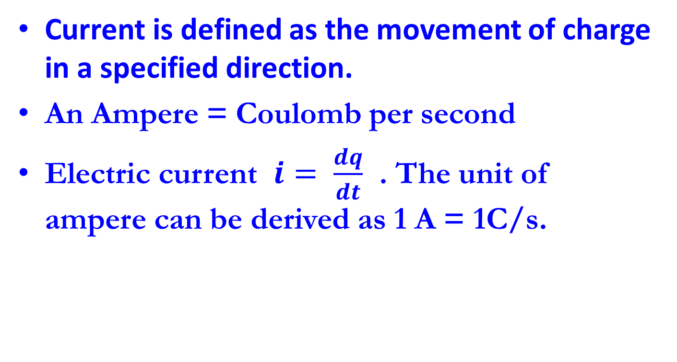
Current
Current is defined as the movement of charge in a specified direction.
An Ampere = Coulomb per second
Electric current $i= \frac{dq}{dt}$ . The unit of ampere can be derived as 1 A = 1C/s.

Slide 5
Type of current
Direct current (arus terus) ) is a current that remains constant with time.
Alternating current (arus ulang-alik) is a current that varies sinusoidal with time. (reverse direction)

Slide 6

Calculating Current
$I= \frac{V_{s}}{R}$
$$= \frac{24 V}{1200 Ω}$$
$$=20 mA$$
Vs = 24 V
R
1.2 kΩ

Slide 7
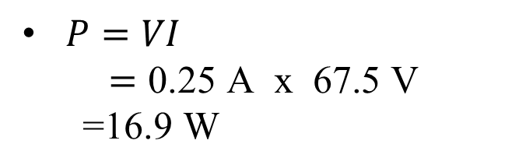
Calculating Power
$P=VI$
$$=\text{0.25 }\text{A} \text{x}\text{ 67.5 }\text{V}$$
$\text{=16.9 }\text{W}$
A
0.25 A
V
67.5 V
270 Ω

Slide 8
Kirchhoff’s Current Law (KCL)
Current entering node = current exiting
Convention: +i is exiting, -i is entering
For any circuit node:

Slide 9
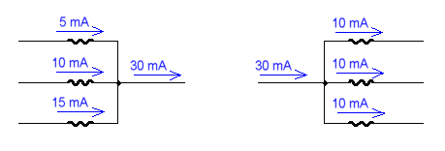
Kirchhoff’s Current Law (KCL)
Kirchhoff’s Current Law (KCL) states that the algebraic sum of current entering a node must be equal to that of leaving the same node.

Slide 10
CURRENT IN SERIES CIRCUIT
Current in series circuit is the same as in each circuit element.

Slide 11
CURRENT IN PARALLEL CIRCUIT
Current in series circuit is equal to the total current for each element circuit

Slide 12
CURRENT DIVIDER
Whenever current has to be divided among resistors in parallel, use current divider rule principle.

Slide 13
Menghitung Ampere Motor 3 dan 1 Phase dengan Rumus Daya
Now, you often seeing in fabrication that electrical motor to operate their machine and more of then is 85% use electrical motor to move their machine.
Electric motor has 2 type of phase. The first is phase 3 and it have R S T voltage and second one is phase 1 and only have phase voltage and neutral ex. Water pump in the house.

Slide 14
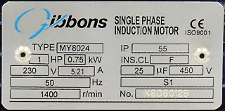
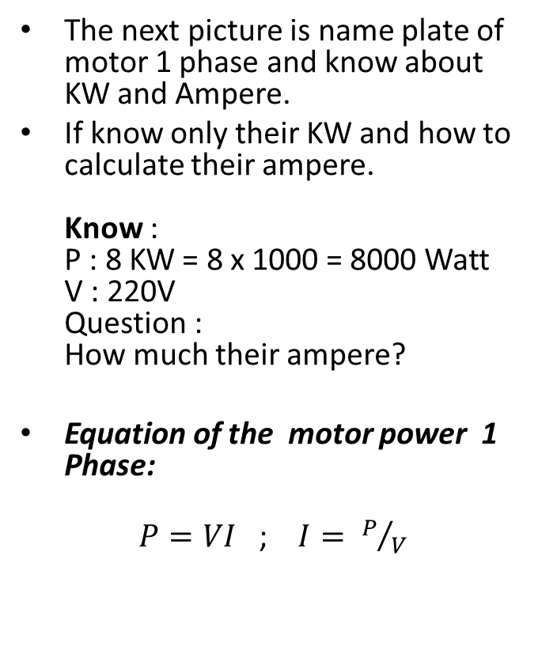
Cara Menghitung Ampere 1 Phase
The next picture is name plate of motor 1 phase and know about KW and Ampere.
If know only their KW and how to calculate their ampere. Know : P : 8 KW = 8 x 1000 = 8000 Watt V : 220V Question : How much their ampere?
Equation of the motor power 1 Phase:
$P=VI$ ; $I= P/V$
Ket: P : Power ( Watt ) I : Current ( Ampere ) V : Voltage ( Voltage )
Answer : I = P/V I = 8000/220 I = 36.36 A
Name Plate of Motor 1 Phase

Slide 15
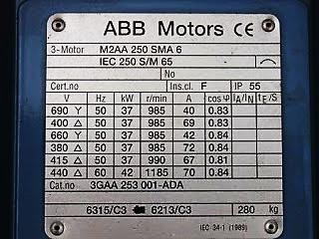
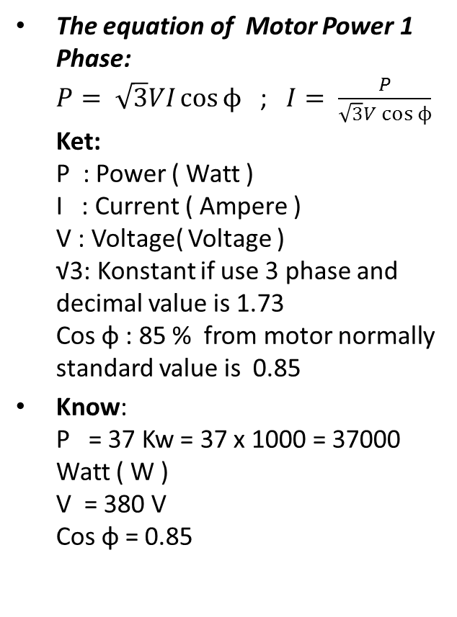
Cara Menghitung Ampere 3 Phase
The equation of Motor Power 1 Phase: $P= \sqrt{3}VI\cos{ϕ}$ ; $I= \frac{P}{\sqrt{3}V\cos{ϕ}}$ Ket: P : Power ( Watt ) I : Current ( Ampere ) V : Voltage( Voltage ) √3: Konstant if use 3 phase and decimal value is 1.73 Cos φ : 85 % from motor normally standard value is 0.85
Know: P = 37 Kw = 37 x 1000 = 37000 Watt ( W ) V = 380 V Cos φ = 0.85
Question : How m,uch the motor ampere? Answer : I = P/(V x √3 x Cos φ) I = 37000 / (380 x 1.73 x 0.85) I = 37000 / 552.22 I = 67 A
Name Plate Motor 3 Phase

Slide 16
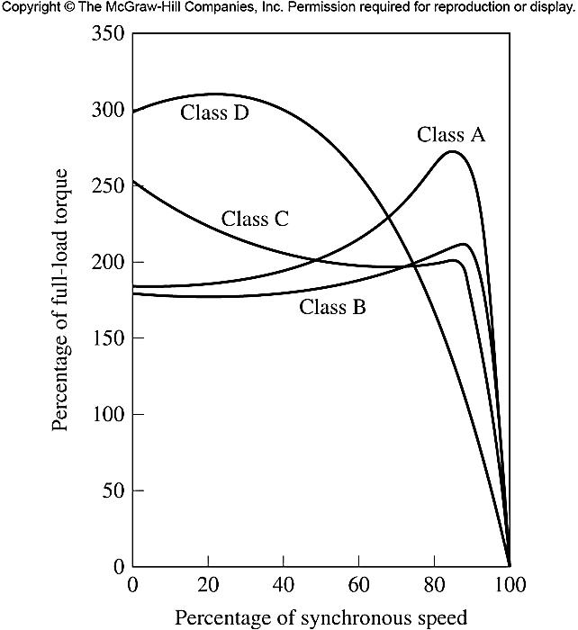
CLASSES OF SQUIRREL CAGE INDUCTION MOTORS
It is possible to produce a large variety of torque-speed curves by varying the rotor characteristics
NEMA (National Electrical Manufacturers Association) in the US and IEC (International Electrotechnical Commission) in the Europe have defined a series of standard to help industry to select appropriate motors.
These standard are referred as design classes.
Figure below shows typical torque-speed curves of four standard NEMA design classes

Slide 17
The characteristics features of each standard design class
. DESIGN CLASS A
Standard motor design
A normal starting torque, a normal starting current, and low slip.
Full-load slip of class A motor must be less than 5% and must be less than class B motor with equivalent rating.
DESIGN CLASS B
Have a normal starting torque, a lower starting current, and low slip.
The motor produces about the same starting torque as class A but with 25% less current.
DESIGN CLASS C
Have a high starting torque, with a low starting currents, and low slip (less than 5% at full load).
The pullout torque is slightly lower than that for class A motors, while starting torque is up to 250% of the full-load torque.
DESIGN CLASS D
Have a very high starting torque (275% or more of the rated torque) and a low starting current, but with a high slip at full load.
The motor produces about the same starting torque as class A but with 25% less current.

Slide 18
STARTING OF INDUCTION MOTORS
Induction motors do not have problem of synchronous motors do
In many cases, they can be started simply by connecting them to power line
However, there a reason for not doing that such that it may cause a dip in power system voltage
For wound- rotor inductions motors, starting can be achieved at relatively low currents by inserting extra resistance in the rotor circuit during starting.
This extra resistance not only increases the starting torque but also reduces the starting current.
For cage induction motors, the starting current can vary widely depending primarily on the motor’s rated power and on the effective rotor resistance at starting conditions.
To estimate the rotor starting current at starting conditions, all cage motors now have a starting code letter

Slide 19
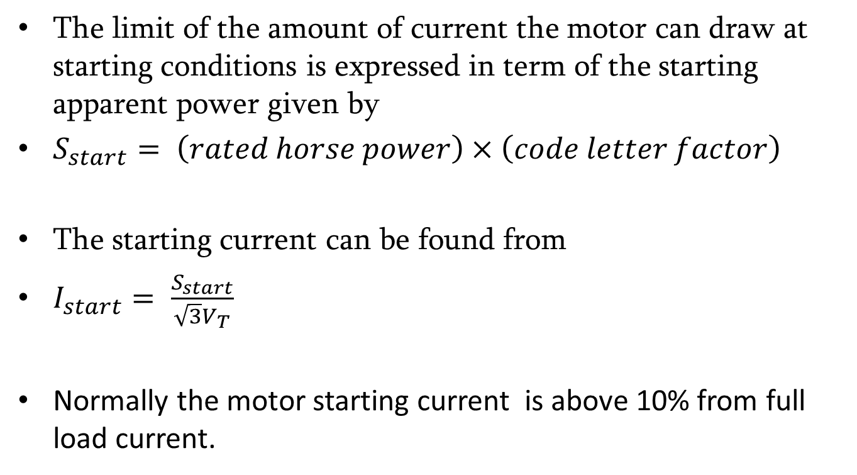
STARTING OF INDUCTION MOTORS
The limit of the amount of current the motor can draw at starting conditions is expressed in term of the starting apparent power given by
$S_{start}= \left(rated horse power\right)×\left(code letter factor\right)$
The starting current can be found from
$I_{start}= \frac{S_{start}}{\sqrt{3}V_{T}}$
Normally the motor starting current is above 10% from full load current.

Slide 20
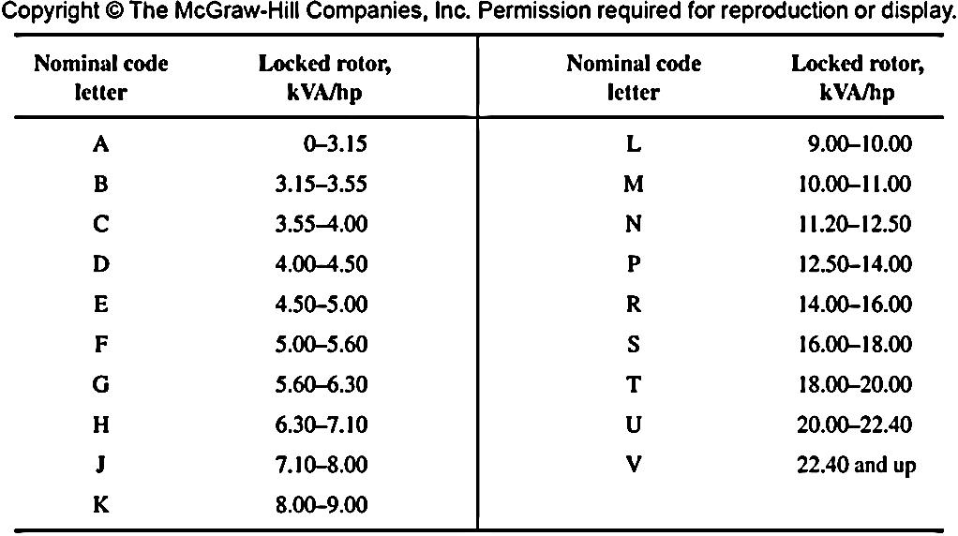
STARTING OF INDUCTION MOTORS
Table of NEMA code letters

Slide 22

Thank you for coming
.

