Slide 1

Perencanaan Sistem Listrik untuk Industri
TEL 12072
Universitas Medan Area
Fakultas Teknik
Oleh
Dr Ir Dina Maizana MT
maizanadina@gmail.com

Slide 2

Mari kita berdoa menurut agama dan kepercayaan masing-masing sebelum kelas dimulai.
Doa dimulai…

Slide 3
Agenda
Kebutuhan daya (Power Demand)
Aliran daya (Power Flow)
Arus beban ( Load Current)
Proteksi gangguan (Protection on Fault)
Cadangan daya ( Power Standby)
Unbreakable PS
Harmonik (Harmonics)
Pentanahan (Grounding)
Penangkal petir (Lightning rod)
Kapasitor bank ( Bank Capacitor)
Penghematan (Savings)

Slide 4
Introduction
The primary function of a protection system in an electrical power network is to ensure the continuity of the electricity supply.
To achieve this, the protection system must be able to:
  Detect the abnormal condition in an electrical circuit or piece of equipment
  Identify the location of the fault
  Isolate the faulty section of the circuit or the faulty equipment only without the electricity supply to the rest of the network.

Slide 5
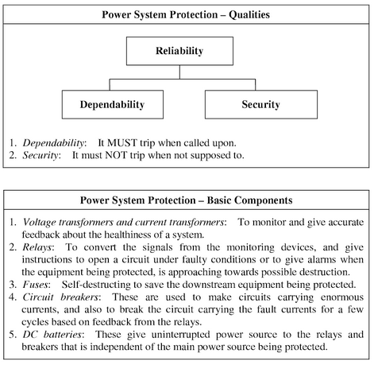

Slide 6
Requirements To Protective System Provide For Basis To Design Criteria
Reliability: Operate dependably when fault conditions occur, even after remaining idle for months or years. Failure to do so may result in costly damages.
Speed: Operate rapidly to minimize fault duration and equipment damage. Any intentional time delays should be precise.
Selectivity: A relay system should provide maximum possible service continuity with minimum system disconnection.
Simplicity: Minimize protection equipment and circuitry.
Economy: Provide maximum protection at minimum cost.

Slide 7
Electrical motor application on industry
Electric drive for textile application
General guidelines for selection motor
  Group v/s industrial drive
  Location of motor
  Special motor for textile application
Standardization of motor
  Give performance specification of motor
Selection of motor for textile process
  Ginning, blowing room
  Preparation machinery
  Spinning
  Winding, warfing and sizing
  Weaving
  Process section
  Pneumatifils

Slide 8
Characteristics of squirrel cage induction motors for textile application
Application | kW range | Speed (syn) r.p.m. | Mounting | Enclosure | Starting Torque %FLT | Breakdown Torque %FLT
Ginning | Upto 7,5 | 1500 | Fout | TEFC | Std | Std
Carding | 1,1 to 2,2 | 1000/750 | Foot/;ug with spring base | TE | Min 6p-350 8p-275 | Min 6p-375 8p-300
Drawing frame | Upto 3,7 | 1500 | Foot/Flange | TEFC | Std | Std
Speed frame | Upto 7,5 | 1500 | Foot | TEFC | Std | Std
Spinning & Doubling | Upto 22 | 1500 or 1000 | Foot | TE | 150-200 | 200-275
Weaving (Loom) | 0,37 to 2,2 | 1000 or 750 | Foot/Flat base/lug with spring base | TEFC | Min 6p-230 8p-200 | Min 6p-270 8p-230
Pneumatifil | 1,1 to 2,2 | 3000 | Foot/Flange/Rod | TE | Std | Std

Slide 9
Remarks:
For drawing frame and speed frame motors, uniform acceleration characteristics similar to spinning frame motors are preferred
For spinning and doubling motors, two single speed motors or one two speed motor are used. Uniform acceleration characteristics are used.
For weaving (Loon) motors: Plain, semi-automatic and automatic-lower starting is permissible in case of clutch drive
For Pneumatifil: motors required to be very compact when mounted inside the filter box.

Slide 10
Electric motor for machine tool application
The main points are
Electric feature : Power supply, Type of motor, characteristic, duty cycle, ambient condition, frame, insulation, bearing, shaft, auxiliaries
Frame, Mounting: Foot/Flange/Face mounting; Enclosure; speed; kW rating; Torque; insulation; duty type; frequent starting and reversing; method braking; high slip motor for punch presses, shears, hammers; multispeed motors.

Slide 11
Electric drives for crane
Crane hooks move; 2 in horizontal plane & 1 in vertical hoist motion.
Hoist motion: required to lift and put down loads without damage.
Cranes for foundries, steel works and power stations generally require creep speeds

Slide 12
Protection
Some abnormal conditions;
  Winding faults: stator-phase and ground fault
  Overload
  Over speed
  Abnormal voltages and frequencies
For generator:
  Under-excitation
  Motoring and startup
For motor;
  Stalling (lock rotor)
  Single phase
  Loss of excitation ( synchronous motor)

Slide 13
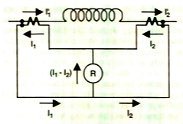
Stator faults
Phase fault protection use differential protection.
For external fault: the relay sees I₁-I₂ ~ 0 or very small; for an internal fault; the relay sees I₁+I₂ ~ very large
The basic differential connection using simple overcurrent relay

Slide 14
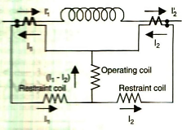
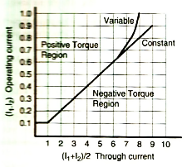
The percentage differential relay

Slide 15
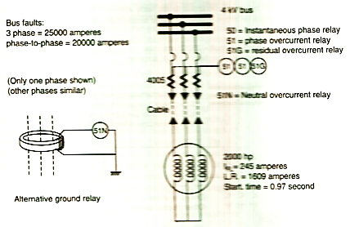
Consider the 2000 hp motor installation. The CT ratio is selected to provide some margin above the trip setting so meters will not read off-scale.
Normally, overcurrent relays are set at 125% of full load and the CT ratio should allow less than 5,0 A for this condition.
If the motor is vital to the operation of the plant, advantage is taken of the motor service factor which is 115%.
This result in maximum load of 245A x 1,15 = 282 A and relay pickup setting of 1,25 x 282 = 352,5 A.
Select a CT ratio of 400 : 5 = 80:1

Slide 16
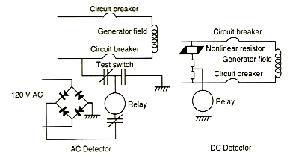
Rotor faults
If ground should occur in the field winding or the buses and circuit breakers external to the rotor, the relay will pick up and actuate an alarm.

Slide 17
Unbalanced current
If will produce more severe heating in machine.
The resulting I²R loss quickly raises the temperature.
The metal will melt, damaging the rotor structure.

Slide 18
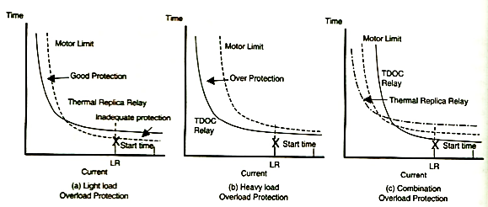
Overload
Use overload protection to protect overheating.

Slide 19
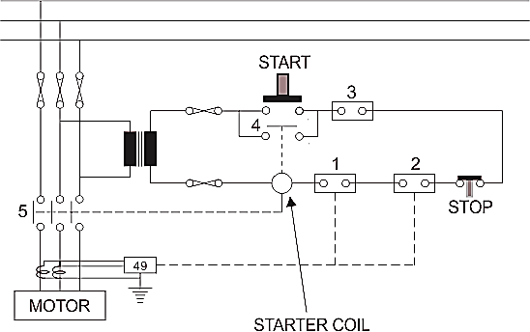
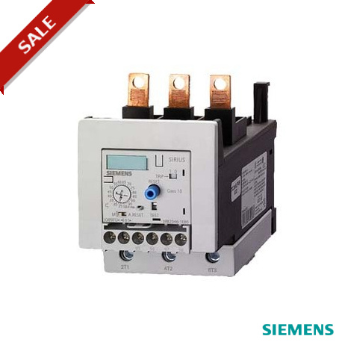
Example thermal overload protection

Slide 20
Over speed
Over speed is not a problem with motors since the normal overcurrent relays will protect them.

Slide 21
Overcurrent relay
A type of protective relay which operates when the load current exceeds a pickup value.
Has two types:
  instantaneous over current (IOC) relay; is an overcurrent relay which has no intentional time delay for operation. The contacts of the relay are closed instantly when the current inside the relay rises beyond the operational value. The time interval between the instant pick-up value and the closing contacts of the relay is very less. It has low operating time and starts operating instantly when the value of current is more than the relay setting.
  definite time overcurrent (DTOC) relay; is a relay that operates after a definite period of time once the current exceeds the pickup value. Hence, this relay has current setting range as well as time setting range.

Slide 22
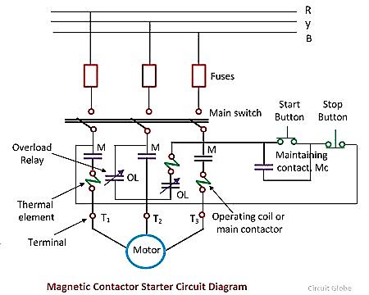
Induction motor protection system

Slide 23
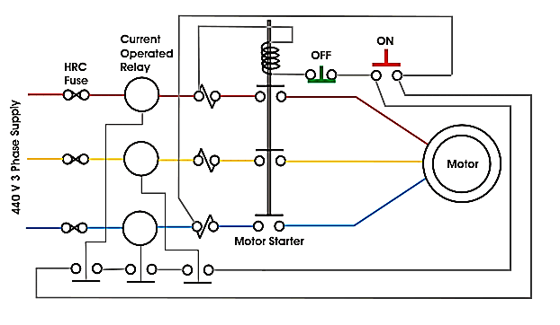
Small and large motor protection sheme

Slide 24
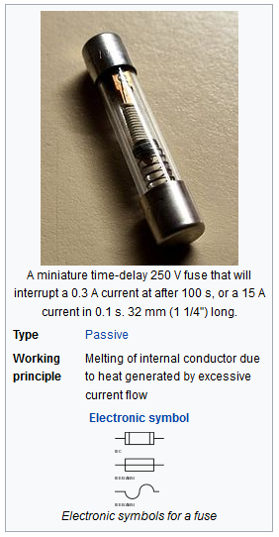
Fuse
fuse is an electrical safety device that operates to provide overcurrent protection of an electrical circuit
A fuse consists of a metal strip or wire fuse element, of small cross-section compared to the circuit conductors, mounted between a pair of electrical terminals, and (usually) enclosed by a non-combustible housing.

Slide 25
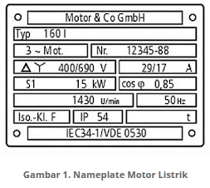
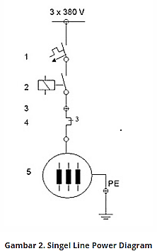
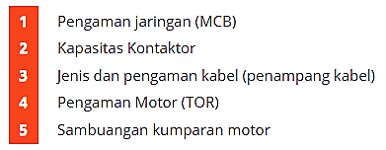
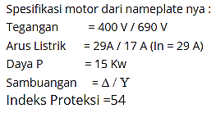
Perhitungan

Slide 26
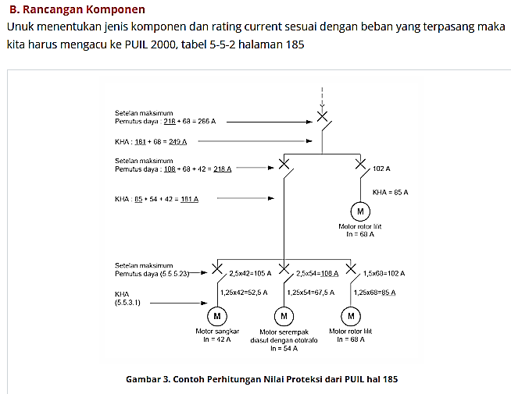

Slide 27
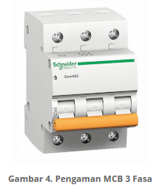
Pengaman jaringan
Pengaman jaringan dipilih dengan MCB atau NFB, berdasarkan perhitungan.
Untuk menentukan besar MCB yang digunakan adalah dengan menggunakan ketentuan :
Nilai minimum = 1,25 x In (dimana In = 29A)
= 1,25 x 29 A
= 36,25 A (minimal 40 A)
Nilai maksimum = 2,5 x In ( dimana In = 29A)
= 2,5 x 29 A
= 75,5 A ( minimal 80 A)
Dari tabel 7.3.1 kita baca data MCB 3 fasa berada direntang 35 A sampai 80A. Salam kasus ini nilai maksimal MCB adalah 63 A.Jika diyakini beban yang akan diberikan adalah maksimal. Perhatikan tabel 7.3.1 PUIL 2000 hal 301

Slide 28
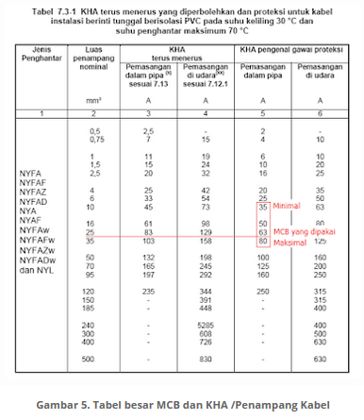

Slide 29
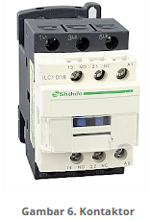
Kontaktor
Kapasitas kontaktor yang dipasang harus mampu dilewati sebesar arus beban maksimum
Spesifikasi kontaktor yang akan dipaang lebih besar dari arus nominal motor (ikontaktor > In) atau sama dengan arus nominal diatas yaitu 63A, atau sama dengan daya motor berdasarkan nameplate di atas 15 kW, jadi kontaktor minimal 15 kW
Kontaktor mempunyai kontak bantu NO atau NC yang terbuat dari bahan perak yang sangat sensitif terhadap adanya busur api dan batas temperatur yang diizinkan (fungsi arus listrik)

Slide 30
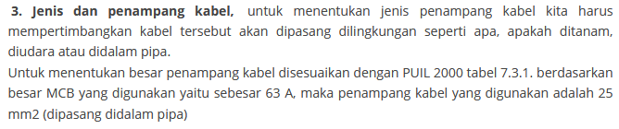
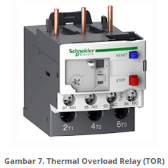

Slide 31
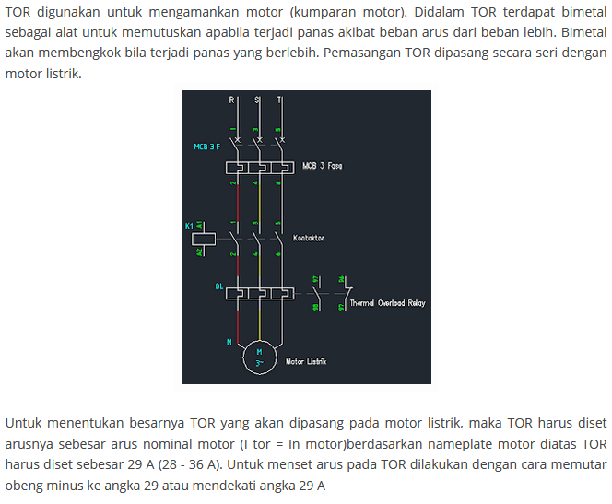

Slide 32
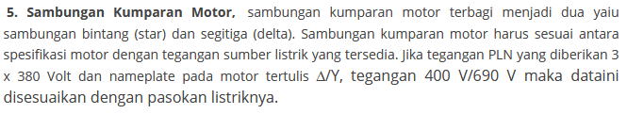
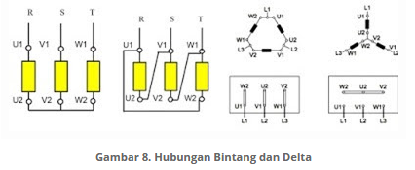
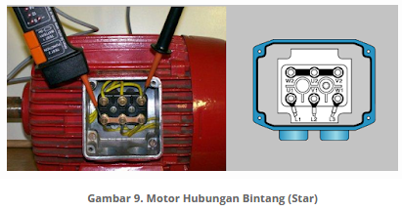
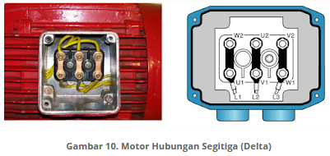

Slide 33
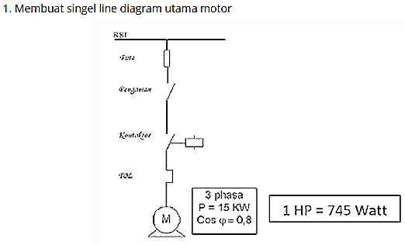

Slide 34
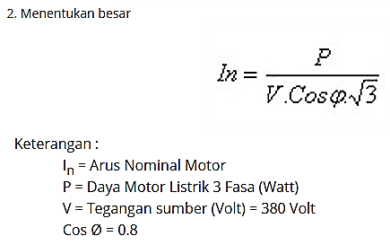

Slide 35
Fuse: 4 x In = 4 x 28,5A [100A]
MCB: 2,5 x In = 2,5 x 28,5 A [71,25A]
Kontaktor (kelas AC 3.1 > In , Kontaktor (kelas AC 3.1 > 28,5 A [35A]
Setting TOR = In = 28,5 A
KHA Kabel = 1,25 x In = 1,25 x 28,5 A [6 mm²]
In = Arus nominal = 28,5A

Slide 36
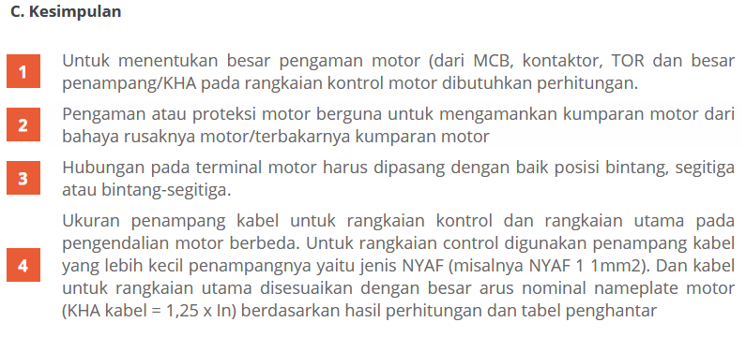

Slide 37
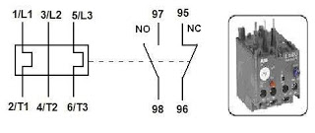
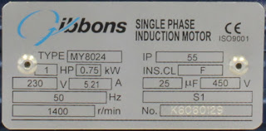
Menghitung Overload Relay, Motor sangat perlu adanya pengamanan beban berlebih yang biasanya di sebut overload, lah untuk pengan tersebut biasanya nama alatnya ada TOR ( Thermar Overload Relay ) tanpa adanya alat ini maka motor bisa keluar asap atau yang sangat parah bisa meledak karena beban ( Load ) yang ditanggung oleh motor tersebut sangat berat maka dari itu aplikasi TOR ini sebagai pemutus disaat beban sudah mendekati batas Maksimum Motor.
TOR sendiri bisa disetting sesui perhitungan yang matang jika tidak maka fungsi TOR sendiri tidak akan berfungsi dengan maksimal, maka dari itu saya bagikan tips untuk menghitung batas maksimum Motor yang harus di setting diTOR tersebut.
Terdapat Motor 3 Fase dengan Name Plate sebagai berikut :
Motor 1 Phase 220V

Slide 38
Dari nameplate motor
Diket :
1. 0,75 Kw
2. 5.21 A
Maka, Dari Ampere saja kita sudah tahu dimana batas maksimum motor Current adalah 10 % dari Ampere Nominal motor,
TOR = A x 10 %
= 5.21 x 0.1
= 0.521 A
Jadi Untuk Settingan TOR adalah A + TOR 10 % = 5.21 + 0.521 = 5.731 A.
Motor 3 Phase 15 Hp
Diket :
1. 3 Hp = 15 x 736 = 11040 W
2. 3 Phase = 1.73
3. Cos Phi = 0.85 standart
Maka, cari dulu amperenya sebagai berikut,
I = P _______
1.73 x V x Cos phi
= 11040 ___
1.73 x 380 x 0.85
= 11040 = 19.75 A
558.79
TOR= A x 10 %
= 19.75 x 0.1
= 1.97 A
Jadi Untuk Settingan TOR adalah A + TOR 10 % = 19.75 + 1.97 = 21.72 A.

Slide 39

Thank you for coming
.

Slide 40
Tugas 1.3

Slide 41
Pada suatu industri yang menggunakan Listrik dari PLN untuk kebutuhan berbagai peralatan listriknya, adapun listrik yang digunakan adalah listrik 3 fasa dengan tegangan 380V/220V, dengan rincian kebutuhan daya berbagai peralatan listrik yang digunakan sebagai berikut:

Slide 42
2 unit Elektro motor 3 fasa 380 V daya 75 kW
2 unit Elektro motor 3 fasa 380 V daya 30 kW
2 unit Elektro motor 3 fasa 380 V daya 15 kW
2 unit Elektro motor 3 fasa 380 V daya 7,5 kW
1 unit Heater 3 fasa 380 V daya 22 kW
1 unit blower 3 fasa 380 V 18 kW
30 buah lampu mercury 250 W (10 buah/fasa) total (30 x250) / 3 = 2,5kW
Total kebutuhan daya = 2x(75+30+15+7,5) +22+18+2,5 = ……. kW

Slide 43
Pertanyaan
Rencanakan sistem proteksi yang sesuai untuk peralatan listrik yang digunakan dalam industri ini.

Slide 44



Rencana 1
FUSE_{M1}=
536,9 A
FUSE_{M2}=
536,9 A
FUSE_{M3}=
214,7 A
FUSE_{M4}=
214,7 A
FUSE_{M5}=
107,4 A
FUSE_{M6}=
107,4 A
FUSE_{M7}=
53,7 A
FUSE_{M8}=
53,7 A
FUSE_{H}=
157,5 A
FUSE_{B}=
128,8 A
FUSE_{L}=
53,5 A
MCB_{M1}=
201,3 A
MCB_{M2}=
201,3 A
MCB_{M3}=
134,2 A
MCB_{M4}=
134,2 A
MCB_{M5}=
67,1 A
MCB_{M6}=
67,1 A
MCB_{M7}=
33,6 A
MCB_{M8}=
33,6 A
MCB_{H}=
98,4 A
MCB_{B}=
80,5 A
MCB_{L}=
33,4 A
TOR_{M1}=
147,6 A
TOR_{M2}=
147,6 A
TOR_{M3}=
59,1 A
TOR_{M4}=
59,1 A
TOR_{M5}=
29,5 A
TOR_{M6}=
29,5 A
TOR_{M7}=
14,8A
TOR_{M8}=
14,8A
TOR_{H}=
43,3 A
TOR_{B}=
35,4A
TOR_{L}=
14,7A
KHA_{M1}=
167,8 A
KHA_{M2}=
167,8 A
KHA_{M3}=
67,1 A
KHA_{M4}=
67,1 A
KHA_{M5}=
33,6 A
KHA_{M6}=
33,6 A
KHA_{M7}=
16,8 A
KHA_{M8}=
16,8 A
KHA_{H}=
49,2 A
KHA_{B}=
40,3 A
KHA_{L}=
16,7 A
I_{n} = 134,2A
I_{n} = 134,2A
I_{n} = 53,7A
I_{n} = 53,7A
I_{n} = 26,8A
I_{n} = 26,8A
I_{n} = 13,4 A
I_{n} = 13,4 A
I_{n} = 39,4 A
I_{n} = 32,2 A
I_{n} = 13,4 A

Slide 45
Rencana 2
FUSE_{M1}
FUSE_{M1}=
536,9 A
FUSE_{M2}
FUSE_{M2}=
536,9 A
FUSE_{M3}
FUSE_{M3}=
214,7 A
FUSE_{M4}
FUSE_{M4}=
214,7 A
FUSE_{M5}
FUSE_{M5}=
107,4 A
FUSE_{M6}
FUSE_{M6}=
107,4 A
FUSE_{M7}
FUSE_{M7}=
53,7 A
FUSE_{M8}
FUSE_{M8}=
53,7 A
FUSE_{H}
FUSE_{H}=
157,5 A
FUSE_{B}
FUSE_{B}=
128,8 A
FUSE_{L}
FUSE_{L}=
53,5 A
MCB_{M1}
MCB_{M1}=
201,3 A
MCB_{M2}
MCB_{M2}=
201,3 A
MCB_{M3}
MCB_{M3}=
134,2 A
MCB_{M4}
MCB_{M4}=
134,2 A
MCB_{M5}
MCB_{M5}=
67,1 A
MCB_{M6}
MCB_{M6}=
67,1 A
MCB_{M7}
MCB_{M7}=
33,6 A
MCB_{M8}
MCB_{M8}=
33,6 A
MCB_{H}
MCB_{H}=
98,4 A
MCB_{B}
MCB_{B}=
80,5 A
MCB_{L}
MCB_{L}=
33,4 A
TOR_{M1}
TOR_{M1}=
147,6 A
TOR_{M2}
TOR_{M2}=
147,6 A
TOR_{M3}
TOR_{M3}=
59,1 A
TOR_{M4}
TOR_{M4}=
59,1 A
TOR_{M5}
TOR_{M5}=
29,5 A
TOR_{M6}
TOR_{M6}=
29,5 A
TOR_{M7}
TOR_{M7}=
14,8A
TOR_{M8}
TOR_{M8}=
14,8A
TOR_{H}
TOR_{H}=
43,3 A
TOR_{B}
TOR_{B}=
35,4A
TOR_{L}
TOR_{L}=
14,7A
KHA_{M1}
KHA_{M1}=
167,8 A
KHA_{M2}
KHA_{M2}=
167,8 A
KHA_{M3}
KHA_{M3}=
67,1 A
KHA_{M4}
KHA_{M4}=
67,1 A
KHA_{M5}
KHA_{M5}=
33,6 A
KHA_{M6}
KHA_{M6}=
33,6 A
KHA_{M7}
KHA_{M7}=
16,8 A
KHA_{M8}
KHA_{M8}=
16,8 A
KHA_{H}
KHA_{H}=
49,2 A
KHA_{B}
KHA_{B}=
40,3 A
KHA_{L}
KHA_{L}=
16,7 A
I_{n} = 134,2A
I_{n} = 134,2A
I_{n} = 53,7A
I_{n} = 53,7A
I_{n} = 26,8A
I_{n} = 26,8A
I_{n} = 13,4 A
I_{n} = 13,4 A
I_{n} = 39,4 A
I_{n} = 32,2 A
Perencanaan sistem listrik untuk industri
I_{n} = 13,4 A

Slide 46
Rencana 3
FUSE_{M1}
FUSE_{M1}=
536,9 A
FUSE_{M2}
FUSE_{M2}=
536,9 A
FUSE_{M3}
FUSE_{M3}=
214,7 A
FUSE_{M4}
FUSE_{M4}=
214,7 A
FUSE_{M5}
FUSE_{M5}=
107,4 A
FUSE_{M6}
FUSE_{M6}=
107,4 A
FUSE_{M7}
FUSE_{M7}=
53,7 A
FUSE_{M8}
FUSE_{M8}=
53,7 A
FUSE_{H}
FUSE_{H}=
157,5 A
FUSE_{B}
FUSE_{B}=
128,8 A
FUSE_{L}
FUSE_{L}=
53,5 A
MCB_{M1}
MCB_{M1}=
201,3 A
MCB_{M2}
MCB_{M2}=
201,3 A
MCB_{M3}
MCB_{M3}=
134,2 A
MCB_{M4}
MCB_{M4}=
134,2 A
MCB_{M5}
MCB_{M5}=
67,1 A
MCB_{M6}
MCB_{M6}=
67,1 A
MCB_{M7}
MCB_{M7}=
33,6 A
MCB_{M8}
MCB_{M8}=
33,6 A
MCB_{H}
MCB_{H}=
98,4 A
MCB_{B}
MCB_{B}=
80,5 A
MCB_{L}
MCB_{L}=
33,4 A
TOR_{M1}
TOR_{M1}=
147,6 A
TOR_{M2}
TOR_{M2}=
147,6 A
TOR_{M3}
TOR_{M3}=
59,1 A
TOR_{M4}
TOR_{M4}=
59,1 A
TOR_{M5}
TOR_{M5}=
29,5 A
TOR_{M6}
TOR_{M6}=
29,5 A
TOR_{M7}
TOR_{M7}=
14,8A
TOR_{M8}
TOR_{M8}=
14,8A
TOR_{H}
TOR_{H}=
43,3 A
TOR_{B}
TOR_{B}=
35,4A
TOR_{L}
TOR_{L}=
14,7A
KHA_{M1}
KHA_{M1}=
167,8 A
KHA_{M2}
KHA_{M2}=
167,8 A
KHA_{M3}
KHA_{M3}=
67,1 A
KHA_{M4}
KHA_{M4}=
67,1 A
KHA_{M5}
KHA_{M5}=
33,6 A
KHA_{M6}
KHA_{M6}=
33,6 A
KHA_{M7}
KHA_{M7}=
16,8 A
KHA_{M8}
KHA_{M8}=
16,8 A
KHA_{H}
KHA_{H}=
49,2 A
KHA_{B}
KHA_{B}=
40,3 A
KHA_{L}
KHA_{L}=
16,7 A
I_{n} = 134,2A
I_{n} = 134,2A
I_{n} = 53,7A
I_{n} = 53,7A
I_{n} = 26,8A
I_{n} = 26,8A
I_{n} = 13,4 A
I_{n} = 13,4 A
I_{n} = 39,4 A
I_{n} = 32,2 A
Perencanaan sistem listrik untuk industri
I_{n} = 13,4 A

Slide 47
Rencana 4
FUSE_{M1}
FUSE_{M1}=
536,9 A
FUSE_{M2}
FUSE_{M2}=
536,9 A
FUSE_{M3}
FUSE_{M3}=
214,7 A
FUSE_{M4}
FUSE_{M4}=
214,7 A
FUSE_{M5}
FUSE_{M5}=
107,4 A
FUSE_{M6}
FUSE_{M6}=
107,4 A
FUSE_{M7}
FUSE_{M7}=
53,7 A
FUSE_{M8}
FUSE_{M8}=
53,7 A
FUSE_{H}
FUSE_{H}=
157,5 A
FUSE_{B}
FUSE_{B}=
128,8 A
FUSE_{L}
FUSE_{L}=
53,5 A
MCB_{M1}
MCB_{M1}=
201,3 A
MCB_{M2}
MCB_{M2}=
201,3 A
MCB_{M3}
MCB_{M3}=
134,2 A
MCB_{M4}
MCB_{M4}=
134,2 A
MCB_{M5}
MCB_{M5}=
67,1 A
MCB_{M6}
MCB_{M6}=
67,1 A
MCB_{M7}
MCB_{M7}=
33,6 A
MCB_{M8}
MCB_{M8}=
33,6 A
MCB_{H}
MCB_{H}=
98,4 A
MCB_{B}
MCB_{B}=
80,5 A
MCB_{L}
MCB_{L}=
33,4 A
TOR_{M1}
TOR_{M1}=
147,6 A
TOR_{M2}
TOR_{M2}=
147,6 A
TOR_{M3}
TOR_{M3}=
59,1 A
TOR_{M4}
TOR_{M4}=
59,1 A
TOR_{M5}
TOR_{M5}=
29,5 A
TOR_{M6}
TOR_{M6}=
29,5 A
TOR_{M7}
TOR_{M7}=
14,8A
TOR_{M8}
TOR_{M8}=
14,8A
TOR_{H}
TOR_{H}=
43,3 A
TOR_{B}
TOR_{B}=
35,4A
TOR_{L}
TOR_{L}=
14,7A
KHA_{M1}
KHA_{M1}=
167,8 A
KHA_{M2}
KHA_{M2}=
167,8 A
KHA_{M3}
KHA_{M3}=
67,1 A
KHA_{M4}
KHA_{M4}=
67,1 A
KHA_{M5}
KHA_{M5}=
33,6 A
KHA_{M6}
KHA_{M6}=
33,6 A
KHA_{M7}
KHA_{M7}=
16,8 A
KHA_{M8}
KHA_{M8}=
16,8 A
KHA_{H}
KHA_{H}=
49,2 A
KHA_{B}
KHA_{B}=
40,3 A
KHA_{L}
KHA_{L}=
16,7 A
I_{n} = 134,2A
I_{n} = 134,2A
I_{n} = 53,7A
I_{n} = 53,7A
I_{n} = 26,8A
I_{n} = 26,8A
I_{n} = 13,4 A
I_{n} = 13,4 A
I_{n} = 39,4 A
I_{n} = 32,2 A
Perencanaan sistem listrik untuk industri
I_{n} = 13,4 A

Slide 48
Rencana 5
FUSE_{M1}
FUSE_{M1}=
536,9 A
FUSE_{M2}
FUSE_{M2}=
536,9 A
FUSE_{M3}
FUSE_{M3}=
214,7 A
FUSE_{M4}
FUSE_{M4}=
214,7 A
FUSE_{M5}
FUSE_{M5}=
107,4 A
FUSE_{M6}
FUSE_{M6}=
107,4 A
FUSE_{M7}
FUSE_{M7}=
53,7 A
FUSE_{M8}
FUSE_{M8}=
53,7 A
FUSE_{H}
FUSE_{H}=
157,5 A
FUSE_{B}
FUSE_{B}=
128,8 A
FUSE_{L}
FUSE_{L}=
53,5 A
MCB_{M1}
MCB_{M1}=
201,3 A
MCB_{M2}
MCB_{M2}=
201,3 A
MCB_{M3}
MCB_{M3}=
134,2 A
MCB_{M4}
MCB_{M4}=
134,2 A
MCB_{M5}
MCB_{M5}=
67,1 A
MCB_{M6}
MCB_{M6}=
67,1 A
MCB_{M7}
MCB_{M7}=
33,6 A
MCB_{M8}
MCB_{M8}=
33,6 A
MCB_{H}
MCB_{H}=
98,4 A
MCB_{B}
MCB_{B}=
80,5 A
MCB_{L}
MCB_{L}=
33,4 A
TOR_{M1}
TOR_{M1}=
147,6 A
TOR_{M2}
TOR_{M2}=
147,6 A
TOR_{M3}
TOR_{M3}=
59,1 A
TOR_{M4}
TOR_{M4}=
59,1 A
TOR_{M5}
TOR_{M5}=
29,5 A
TOR_{M6}
TOR_{M6}=
29,5 A
TOR_{M7}
TOR_{M7}=
14,8A
TOR_{M8}
TOR_{M8}=
14,8A
TOR_{H}
TOR_{H}=
43,3 A
TOR_{B}
TOR_{B}=
35,4A
TOR_{L}
TOR_{L}=
14,7A
KHA_{M1}
KHA_{M1}=
167,8 A
KHA_{M2}
KHA_{M2}=
167,8 A
KHA_{M3}
KHA_{M3}=
67,1 A
KHA_{M4}
KHA_{M4}=
67,1 A
KHA_{M5}
KHA_{M5}=
33,6 A
KHA_{M6}
KHA_{M6}=
33,6 A
KHA_{M7}
KHA_{M7}=
16,8 A
KHA_{M8}
KHA_{M8}=
16,8 A
KHA_{H}
KHA_{H}=
49,2 A
KHA_{B}
KHA_{B}=
40,3 A
KHA_{L}
KHA_{L}=
16,7 A
I_{n} = 134,2A
I_{n} = 134,2A
I_{n} = 53,7A
I_{n} = 53,7A
I_{n} = 26,8A
I_{n} = 26,8A
I_{n} = 13,4 A
I_{n} = 13,4 A
I_{n} = 39,4 A
I_{n} = 32,2 A
Perencanaan sistem listrik untuk industri
I_{n} = 13,4 A

