Slide 1

Perencanaan Sistem Listrik untuk Industri TEL 12072
Universitas Medan Area
Fakultas Teknik
Oleh
Dr Ir Dina Maizana MT
maizanadina@gmail.com

Slide 2

Mari kita berdoa menurut agama dan kepercayaan masing-masing sebelum kelas dimulai.
Doa dimulai…

Slide 3
Agenda
Kebutuhan daya (Power Demand)
Aliran daya (Power Flow)
Arus beban ( Load Current)
Proteksi gangguan (Protection on Fault)
Cadangan daya ( Power Standby)
Uninterruptible power supply (UPS)
Harmonik (Harmonics)
Pentanahan (Grounding)
Penangkal petir (Lightning rod)
Kapasitor bank ( Bank Capacitor)
Keselamatan (Savings)

Slide 4
UNINTERRUPTIBLE POWER SUPPLIES (UPS)
UPS systems provide uninterrupted, reliable and high-quality power for
vital loads.
Applications : medical facilities, life-support systems, data
storage and computer systems, emergency equipment, telecommunication,
industrial processing and on-line management systems.
An ideal UPS should have the features :
a) Regulated sinusoidal output voltage with low THD.
b) On-line operation, i.e. zero switching time from normal to backup and vice versa.
c) Low THD sinusoidal input current and unity PF.
d) Electrical isolation of the battery and output with respect to input.
e) Low maintenance, cost, weight and size.
f) High efficiency and high reliability.

Slide 5
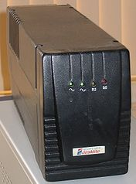
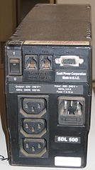
A small free-standing UPS with one IEC 60320 C14 input and three C13 outputs

Slide 6
Common power problems
There are various common power problems that UPS units are used to correct:
1. Power failure
2. Voltage sag
3. Voltage spike
4. Under-voltage (brownout)
5. Over-voltage
6. Line noise
7. Frequency variation
8. Switching transient
9. Harmonic distortion

Slide 7
Classification :
A. Static UPS
i) On-line UPS
ii) Off-line UPS
iii) Line interactive UPS
B. Rotary UPS
C. Hybrid static / Rotary UPS

Slide 8
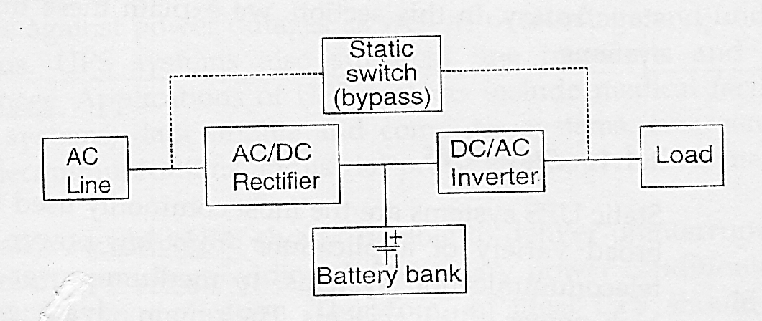
i) On-line UPS
Has 3 modes of operation:
i) Normal operation
ii) Stored energy mode of operation
iii) Bypass mode of operation

Slide 9
Its power rating of the rectifier is required to meet 100%
of the power demanded by the load as well as power demanded for charging the battery bank.
The inverter is rated at 100% of the load power since it must supply the load during the normal mode of operation as well as during the backup time.
The main advantages of this topology :
Very wide tolerance to the input voltage variation.
Very precise regulation of output voltage.
Possibility to change or regulate the output frequency.
No transfer time during the transition from normal to stored energy mode.

Slide 10
The main disadvantages :
Low power factor
High THD at the input (rectifier)
Low efficiency (because of double-conversion)
Despite of the disadvantages, double-conversion UPS is the most preferred, ranging from few kVA to several MVA in applications.
There are 2 major types of double-conversion topologies :
a) With a low-frequency isolating transformer
b) With a high-frequency isolating transformer

Slide 11
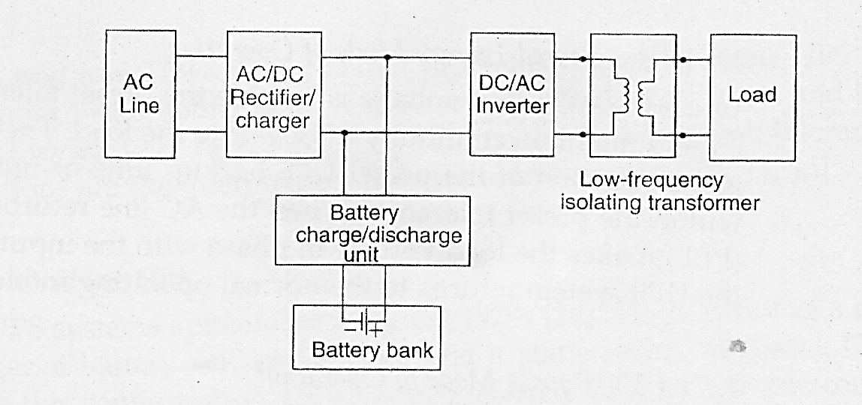
Block diagram of On-line UPS with a low-frequency isolating transformer at the output
Drawbacks :
a) Large isolating transformer (freq. less than 2kHz)
b) High acoustic noise from transformer
c) Poor transient response to the load and input voltage

Slide 12
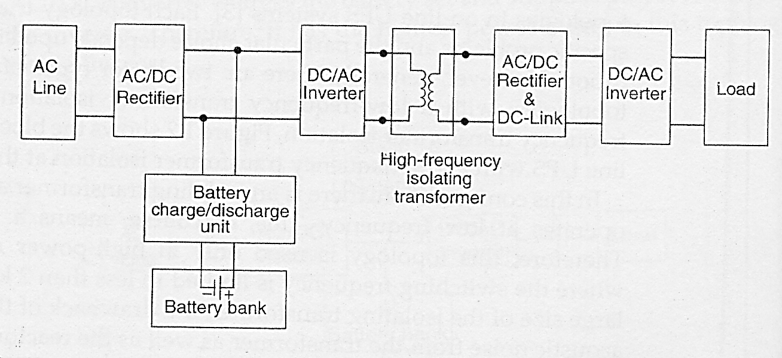
Block diagram of On-line UPS with a high-frequency isolating transformer at the output
Advantage : Switching frequency beyond 20kHz, reduce transformer weight,
transformer size and the size of output filter.
Disadvantage : Additional rectifier and inverter, adding up to cost and
extra power losses, hence reducing overall efficiency.

Slide 13
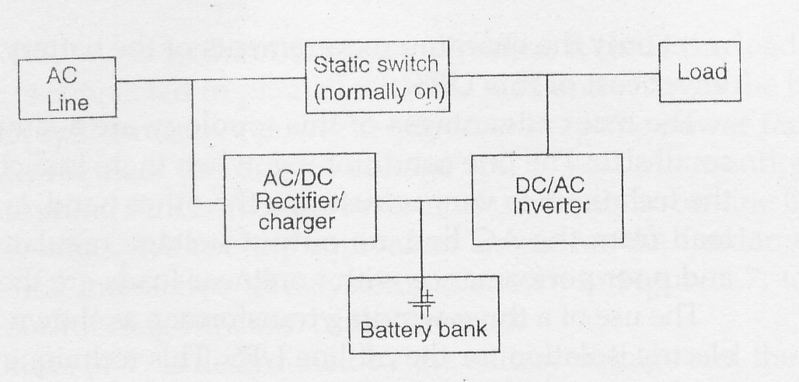
ii) Off-line UPS

Slide 14
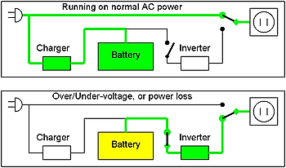
ii) Off-line UPS
Offline / standby UPS. Typical protection time: 0 - 20 minutes.

Slide 15
Is also known as standby UPS.
The load is supplied with power from AC line directly without any power conditioning.
It is rated at a much lower power rating than the rectifier/charger in an on-line UPS since it is not required to meet the power demand of the load.
It is connected in parallel to the load and stays standby during normal operating mode.
Main advantages :
Simple design
Low cost
Small size
Main disadvantages :
Poor performance with nonlinear loads
Long switching time to backup power
No output voltage regulation

Slide 16
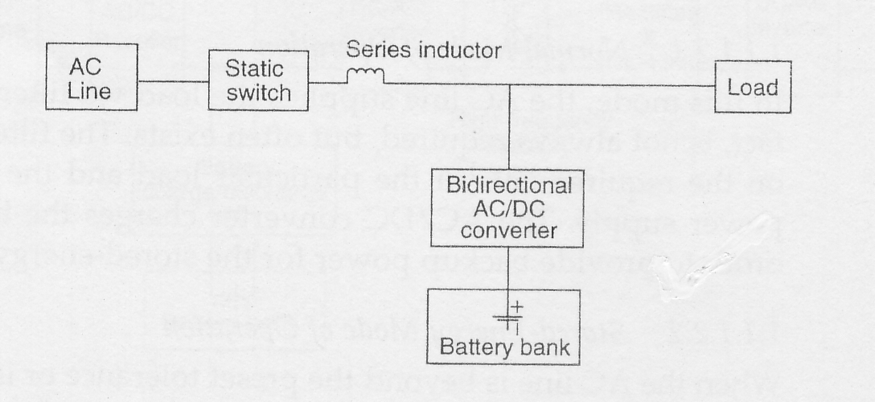
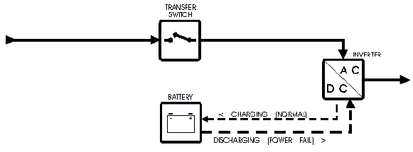
iii) Line-Interactive UPS

Slide 17
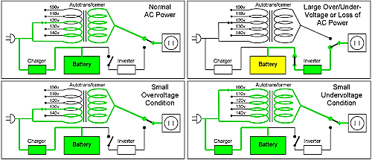
iii) Line-Interactive UPS
Line-Interactive UPS. Typical protection time: 5 - 30 minutes.

Slide 18
The line-interactive UPS can operate as an on-line UPS or as off-line UPS.
For an off-line UPS, the series inductor is not required.
However, most line-interactive UPS operate on-line, in order to either improve the PF of the load or to regulate the output voltage for the load.

Slide 19
Main advantages (line interactive UPS) :
Simple design as compare to online UPS ; resulting to high reliability and low cost.
Good harmonic suppression for input current.
High efficiency (having only single stage conversion).
Main disadvantages :
Lack of effective isolation of the load from the AC line.
Installing isolation transformer will add to cost, size and weight of the UPS system.
Output voltage conditioning is not good because inverter is not connected in series with the load.

Slide 20
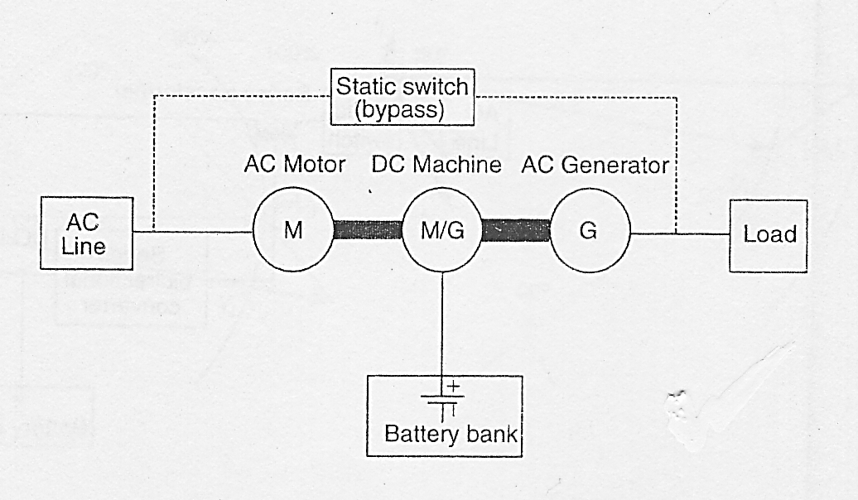
Rotary UPS
Two operating modes :
a) Normal
b) Stored energy

Slide 21
Rotary UPS
A Rotary UPS uses the inertia of a high-mass spinning flywheel to provide short-term ride-through in the event of power loss.
The flywheel also acts as a buffer against power spikes and sags, since such short-term power events are not able to appreciably affect the rotational speed of the high-mass flywheel.
can be considered to be online since it spins continuously under normal conditions. However, unlike a battery-based UPS, flywheel based UPS systems typically provide 10 to 20 seconds of protection before the flywheel has slowed and power output stops.
Typical protection time:
20 – 60 seconds
Capacity expansion:
Several seconds

Slide 22
Rotary UPS
traditionally used in conjunction with standby diesel generators, providing backup power only for the brief period of time the engine needs to start running and stabilize its output.
The Rotary UPS is generally reserved for applications needing more than 10,000 watts of protection,
Larger flywheel or multiple flywheels operating in parallel will increase the reserve running time or capacity.
Typical protection time:
20 – 60 seconds
Capacity expansion:
Several seconds

Slide 23
The rotary UPS are more reliable than static UPS system.
However, they require more maintenance and have much larger size and weight.
They have many advantages making them desirable in high power applications.
One of the advantage of the rotary UPS system is that the transient overload capability is 300 to 600% of the full load for rapid fault clearing.
Performance with nonlinear loads is good because of low output impedance.
The input current THD is very low, typically less than 3%. EMI also low and efficiency usually 85% or higher.

Slide 24
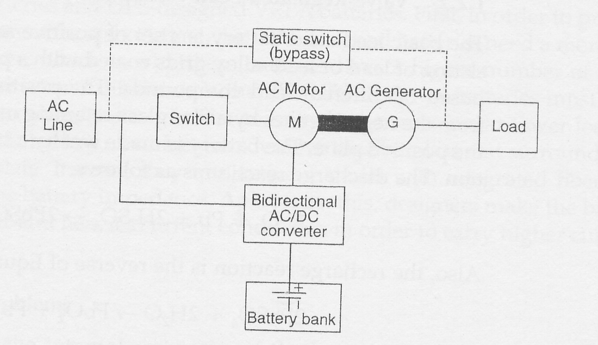
Hybrid Static / Rotary UPS

Slide 25
This type of UPS combine the features of both static and rotary UPS systems.
They have low output impedance, high reliability, excellent frequency stability and low maintenance cost.
Two modes operation :
1. Normal operation mode, the AC motor is fed from the AC line and drives the generator. The AC generator supplies the load. The bidirectional converter, which behaves as a rectifier, charges the battery bank.
2. During the storage energy mode operation, the inverter supplies the AC generator from the battery bank through the AC motor. In fact, the bidirectional converter, which behaves as an inverter, drives the AC motor. The AC motor drives the generator supplying the load.

Slide 26
When internal malfunction in the UPS system occurs, the static switch (bypass) is turned on and the load directly supplied from the AC line.
However, since the AC line and output voltage are not synchronized, the transition is not transient-free.

Slide 27
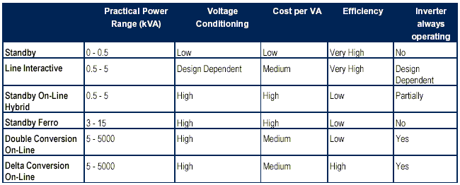
Summary of UPS types :

Slide 28
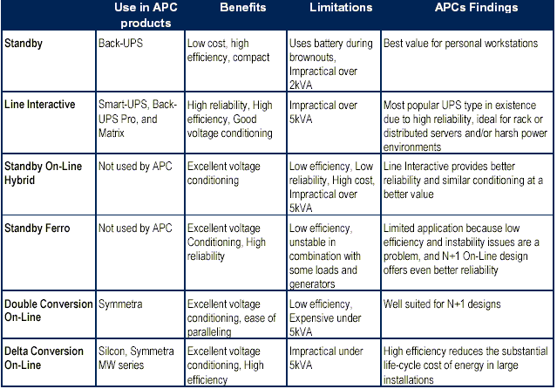
UPS types in the industry

Slide 29
Tutorial : UPS
Discuss below question and concerns reasonable to the marks given.
What are UPS for? 5 marks
Where usually UPS being installed ? 5 marks
What are the main categories of available UPS ? Differentiate them. 10 marks
Built a block diagram to summarise the process flow of each UPS. 20 marks
Built a table to summarise the different between the UPS . 10 marks
What are the urging and limiting factors may contribute to determination of UPS system to propose? 10 marks
For electrical power supply quality issues, fill in the table. First row is being furbished as example. You may include more than one row if there are more apparatus involved. 20 marks

Slide 30
Places | Severity (critical, major, minor, cosmetic) | Reason | Critical Apparatus to be covered | Duration | Possible UPS to be installed | Limitation or Constrain to be justified | Practical UPS to be proposed
Cinema | Cosmetic | Interruption may bring discomfort. Worst case, audience need lighting source to evacuate. | Illumination or lighting | Within 30 minutes. Or enough for evacuation purpose. | Online , off-line, Line-interactive | Initial Cost, installation space, level of power quality needed. | 1) Off-line (gen set if open space is available ) 2) off-line with batteries (if in confined area)
High rise building
Lecture hall
Bank
Hospital
Shopping complex

Slide 31

Thank you for coming
.

